Slide 1
Resampling
Class # 13
October 15, 2019

Slide 2
Announcements
HW6 posted
Reading for today: ISLR 5.1-5.2
Reading for Thursday
ISLR 6.1-6.2
Metz (NYT 2019; see readme in github reading folder for this day)

Slide 3
Today’s topic: Resampling
What you can do with resampling:
Model selection
Measuring the accuracy of parameter estimates
Parameters can be model coefficients
But they can also be other quantities you’d like to compute with the model.
When you’ll (most likely) use which method:
Cross validation for model selection.
This is a way to use your computer to do better than AIC.
Bootstrapping for measuring parameter accuracy.
This is a way to use your computer to construct confidence intervals.

Slide 4
What you’ll learn
A few approaches to construct test mean square error estimates from your data

Slide 5
We have two terminology issues to deal with
First, “resampling”
In ISLR, resampling means repeatedly pulling sub samples from your data.
If your data are a sample from the population, then we’re creating new samples from the original.
But in pandas, resampling can also mean aggregating your data,
e.g. taking all data from a particular time window and averaging them.
We’ll see this in the notebook today.

Slide 6
Second Terminology issue: train, validate, test
Training data: Data used to fit a model’s parameters
e.g. β values in a linear model
Validation data: used to choose a model’s hyperparameters.
We haven’t learned about these yet, but we will soon.
For now: hyperparameters govern how flexible a model will be
They are critical for balancing the bias-variance tradeoff.
Testing data
This is a fraction of data you withhold for final analysis
You DON’T use these data to fit any type of parameter
Compare test data error across modeling strategies, e.g. KNN vs OLS, choose best
Notes:
Image source: Kaggle.com

Slide 7
Training, validation, testing…
In cross-validation (what we’re about to do)
Training data and validation data are pulled from the same block of data over and over again (more soon)
The testing data are only used for a single evaluation step.
Ambiguity alert: “Test error” can refer to
The average error measured across all validation partitions of the data
The error obtained by evaluating your best possible model against the test data
Take-home message: Test error need not refer to error obtained with the test data. Sigh!
Instead it is any error other than training error.

Slide 8
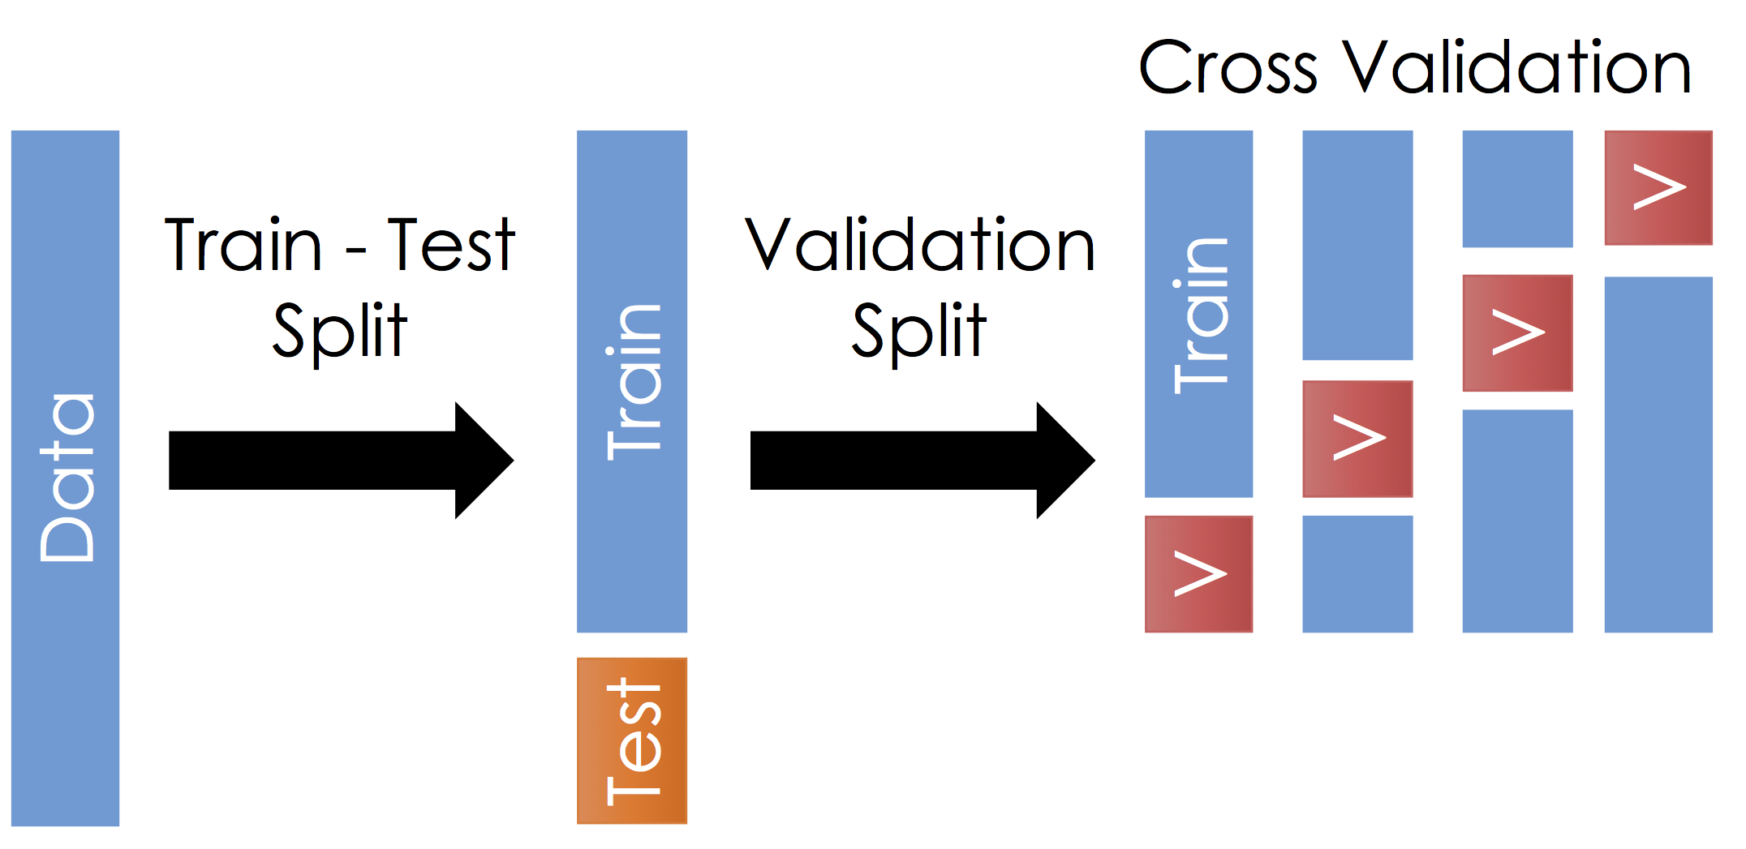
Train, validate, test…

Slide 9
Let’s return to the task at hand…
Model selection!
So far we have mostly focused on model identification, or the process of choosing model parameters.
But we also used AIC to do model selection, i.e. to learn which type of model we should use. For example:
How many features in my OLS model?
What size k for KNN?
AIC works for OLS specifications.
But what about KNN and all the other methods we’re about to learn?

Slide 10
What is an objective measure we can use for model selection, if AIC won’t work for us?
Hint: use data that the model has not been trained on
Answer: mean squared test error, where test data were not used to train the model
Why do this?
We avoid choosing a model that has overfit the data.
Which is a symptom of overfit: bias or variance?
Variance!

Slide 11
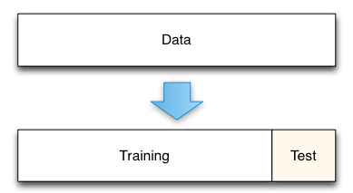
Test and Train data
If you just split the data once, you may get undesirable results:
Your error rate may depend strongly on the characteristics of the random split
You’re only using a fraction of the data for validation.
You’re only using a fraction of the data for training
Notes:
Image source: Kaggle.com

Slide 12
Enter “cross validation”
Basic idea:
Break your data up into groups. Give each group a chance to be the test data set, and use the remaining data for training

Slide 13
Two basic types of cross validation
“Leave one out” cross validation
n observations means you’ll train n different models with (n-1) observations.
Compute the error for each withheld observation
We’ll talk about this first
k-fold cross validation
k “folds” mean you train k < n different models.
Compute the error for each withheld “fold” of observations
We’ll talk about this second
Remember, these are model selection strategies
They serve the same purpose as something like AIC
They work outside the confines of OLS

Slide 14
Leave One Out Cross validation…
Allows you to use all the data for testing / validation
Provides one estimate of the test error.
The basic idea is to repeatedly split the data such that you “leave out” each observation once.
Use remaining observations to train a model
Use left-out observation to compute a test error
Do this n times!
Notes:
Figure: ISLR 5.3

Slide 15
Leave One Out Cross validation (LOOCV)
For all i, pull the observation (x_{i}, y_{i}) out and fit the data to the remaining data.
Call the estimate of y_{i} from the “one-left-out” model y_{i}
Then MSE_{i} = (y_{i} - y_{i})² (note this is an average of one value!)
Then the error estimate for this “leave one out” process is
…where the sum is over all n – i.e. n models were fit, each time fitting a different subset of the data.
Note the subscript on CV is n because we split the data n times

Slide 16
LOOCV advantages to using just one split
Test error when you split just once tends to overestimate error more than LOOCV
This is because you use more data to fit each model with LOOCV
By using every possible split, there is no variation in the estimate of error.
On the other hand, if you use just one validation set, the error depends strongly your random split.
For some special cases you don’t even need to do the resampling
See Equation 5.2

Slide 17
k-fold cross validation
Randomly divide the set into k equal groups, or “folds”
k ≤ n
LOOCV is n-fold cross validation
Every observation gets assigned to a group to make sure we use all the data
For each fold:
Withhold the fold and train a model with the remaining data
Compute MSE_{i} = the average of errors for all withheld observations in the fold.
Then:
Advantage of k-fold over LOOCV?
Only k folds (rather than n) – computationally easier

Slide 18
Test with training data
10 different validation data sets
Validation can be used for model selection.
In these figures (Auto data set from the book) the minima are in different locations for different validation approaches
10-fold: each line is a different random split into 10 folds.

Slide 19
k-fold on classification problems?
Yep, pretty simple to extend. Here it is for n-fold (LOOCV)
Where Err_{i} is the error rate (misclassified / total)

Slide 20
What should k be?
Rule of thumb: k = 5 to 10.

Slide 21
Let’s look at today’s notebook.
Here is the interact link.

Slide 22
The Bootstrap
Standard error -- what is it?
A measure of the average difference between an estimate of a parameter and the true value of the parameter.
Standard errors can be computed with simple formulae in some cases, for example for coefficients fit using ordinary least squares (OLS) regression
However for many other cases there is no simple formula
When the assumptions required to apply the formulae don’t apply, even if you’re doing OLS
For example if your errors are strongly correlated
When you’re using a different algorithm to fit your model, for example linear discriminant analysis.

Slide 23
Computing the standard error numerically
If you can’t directly apply a formula to compute the standard error, you might be able to use your computer to construct the distribution
You could draw new sets of samples from your population repeatedly and recompute the parameter of interest
For example draw a set of N = 100 observations and repeat B = 1,000 times
The average parameter estimate across the B draws will be the true parameter, and you can measure the standard error from the distribution of parameter estimates
But! We can’t usually repeatedly sample from the true population
You can’t go out and re-survey a new set of 100 randomly chosen 1,000 times (or else you’ll never graduate!)

Slide 24
Enter the bootstrap
First key idea: create a new sample from your original sample by sampling with replacement.
Repeat this B times
Record the parameters you care about each time
The average parameter estimate will equal the true parameter
Second key idea: the standard error of the parameter estimate will be roughly the true standard error.

Slide 25
In other words…
Say it again: the standard error of the bootstrapped parameter estimates is a decent approximation of true standard error.
“The population is to the sample as the sample is to the bootstrapped sample”
How many in the sample? How many samples?
N = (Rule of thumb) Make your samples equal in size to the original sample
B = (Good practice) keep generating new samples until your estimates (parameter average and standard error) converge

Slide 26
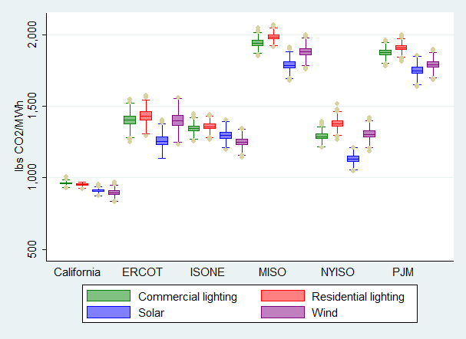
What can I bootstrap?
This is one of the advantages of bootstrapping: anything you might want to calculate from your data, you can bootstrap.
You don’t need to limit yourself to regression coefficients
Example: bootstrapped estimates of CO2 avoided by implementing various technologies in different locations (Callaway, Fowlie and McCormick, JAERE 2017)

Slide 27
Summary
Cross validation is a neat way to create a test error without ignoring parts of your data
But note, by using the cross validation error to choose a hyperparameter (like polynomial order, or k in KNN) the final model does “see” all the data, though indirectly
So to compare different kinds of models:
We will withhold a “test” data set and use this at the very end
There is no getting around the problem that we can’t use all data to train the model
Bootstrapping is a method to construct standard errors for parameters
Less relevant for machine learning, but a close sibling to cross-validation
Key difference: sample with replacement to simulate a data collection process in which samples are randomly collected

